Slide 1

18CSC202J - OBJECT ORIENTED DESIGN AND PROGRAMMING
Session 12
Topic : UML Component Diagram, Deployment Diagram

Slide 2
Guidelines to Draw: Component Diagram
Based on the analysis of the problem description of the system, identify the major subsystem.
Group the individual packages and other logical entities in the system to provide as separate components.
Then identify the interfaces needed for components interaction.
If needed, identify the subprograms which are part of each of the components and draw them along with their associated components.
Use appropriate notations to draw the complete component diagram.

Slide 3


Notations
S.NO | NAME | SYMBOL | DESCRIPTION
1 | Component |  | Component is used to represent any part of a system for which UML diagrams are made.
2 | Association |  | A structural relationship describing a set of links connected between objects.

Slide 4
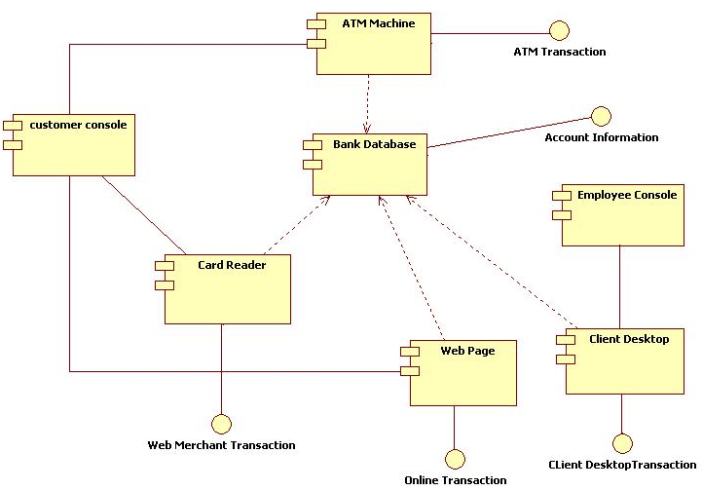
Example

Slide 5
Deployment Diagram
A deployment diagram shows the physical placement of components in nodes over a network.
A deployment diagram can be drawn by identifying nodes and components.
A deployment diagram usually describes the resources required for processing and the installation of software components in those resources.

Slide 6
Purpose
It shows the relationship between software and hardware components in the target system.
They are useful to show the system design that has subsystem, concurrent execution, compile time and execution time invocations, and hardware/software mapping by assigning the appropriate software components to the hardware devices.
As they specify the distribution of software components in various devices and processors in the target environment, it will be easier for maintenance activities.
Using this diagram it is easier to identify performance bottlenecks.

